Slide 1

Graduation Project
V2X
Prepared By
Diaa Abdeltoab Ramdan
Mohamed Rageb Mohamed
Mohamed Alaa Rushdi
Mustafa Mohamed Shaban
Ahmed Mohamed Rabia
Khaled Atef Mahmoud
Supervisor By
Date of examination
DR. Mohamed Hamdy
2, July 2024

Slide 2
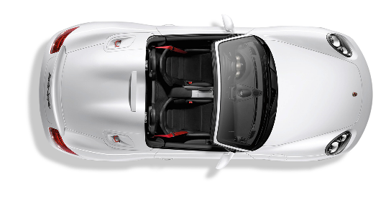
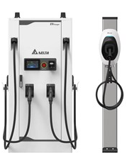




What is V2X ?
V2V
V2G
V2I
V2I
V2C

Slide 3
Why V2X

Slide 4
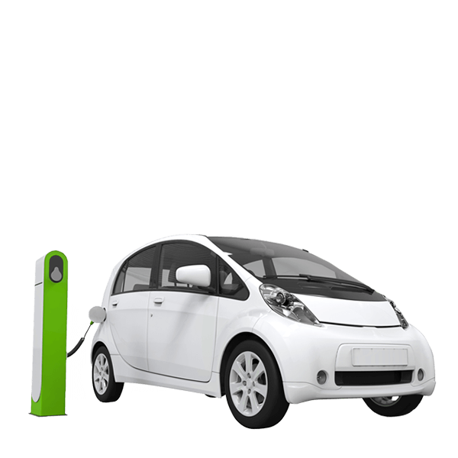



V2X
In Our
Project
AI-Assistance
V2I
V2P
V2G
intgeration
Self-Driving
Mobile App

Slide 5
How Project Work?
Hardware
Software
1
STM-32
1
Mobile Application
2
STM-32 Layer
2
ESP-32
Service Layer
3
Mobile
(GUI-V2G)
HAL Layer
TFT-Sensor-MotorDiver
MCAL
GPIO-RCC-EXII-UART
3
ML Model

Slide 6





How Communication ?
Identification
1
Vehicle ID
2
X ID

Slide 7
1
Vehicle ID
Vehicle
XP7SA1DG9SFC14705
VIN

Slide 8



2
X ID
Anything
ID | S-ID
R1-1-001
ID
S-ID

Slide 9


How Communication ?
Range
Every I : has Fixed Range
Every P : has Variable Range
Every V : has Variable Range

Slide 10

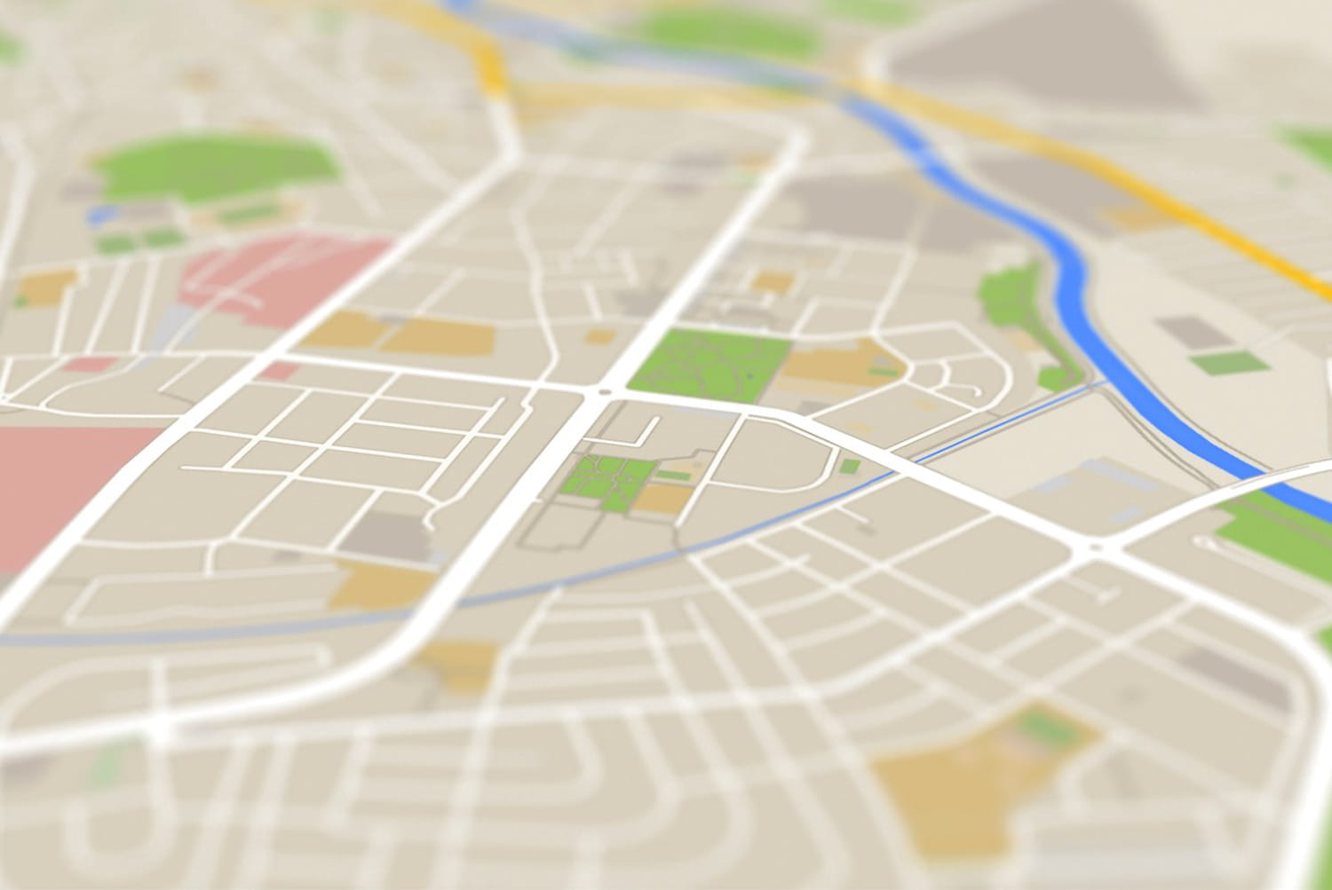

How Create Range ?
30.7114331 - 29.3010733
Longitude
Latitude

Slide 11
How Create Range ?
30.7114 - 29.3010

Slide 12
How Create Range ?
30.71 - 29.30

Slide 13
V2X Range
V2X
Vehicle
Everything
Variable Location
Variable Location
Fixed Location

Slide 14
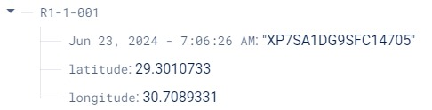
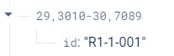
V2I Communication
Start Communcation
With Cloud DB

Slide 15
Vehicle Range
Latitude
Longitude
29.3010733
30.7114331
29.3010
30.7114
Vehicle Range
29.3010-30.7114

Slide 16
Check Vehicle in Range
IF
Sign Range
Vehicle Range
29.3010-30.7114
29.3010-30.7114
t
Car read ID Sign
Recgonize Sign to take action
Search ID Sign read and write in
Sign topic

Slide 17

Vehicle Move out Sign Range

Slide 18
Vehicle-Sign Degree
Bearing Degree
Compass Degree
Vehicle-Sign Degree = Bearing Degree – Compass Degree
< 60

Slide 19

V2I Communication
01
Vehicle
Display
Traffic light
Display
Stop sign
Display
Speed Limt
Display info
02
Traffic
Send Warning
To
Emergency
Detect Accidents
03
Control
Emergency
Control Traffic
Lights
Traffic Lights

Slide 20
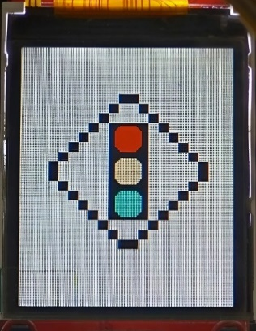
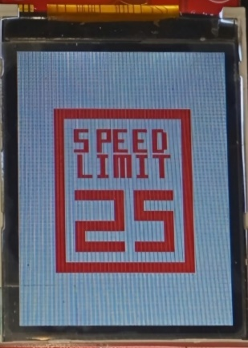
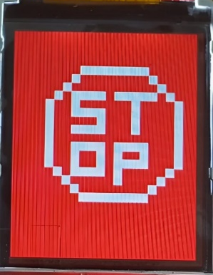
01
Vehicle
Display info
Display
Traffic light
Display
Stop sign
Display
Speed Limt
Notes:
TFT

Slide 21




02
Traffic
Detect Accidents
How Work ?
1
Detect Accident Camera ‘s Traffic Light
2
Convert to Red Status and Write Warning in DB
3
Warning and send ID Traffic to Emergency
2
3
1
Firebase Cloud

Slide 22
03
Control
Traffic Lights
How Work ?
1
Emergency Car Enter The Range
2
Emergency Car has access to near traffic light
3
Emergency Car turn on (green)

Slide 23
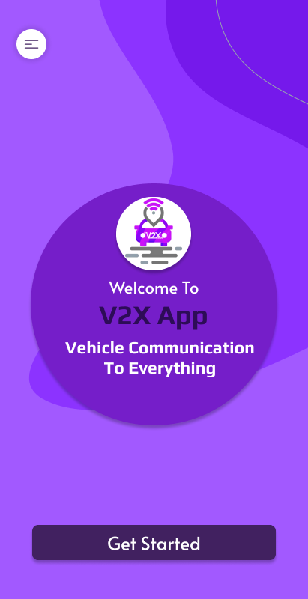


Mobile Application
Why APP ?
1
Warning
2
GPS Problem
Tools
1
UI/UX
2
Framework

Slide 24
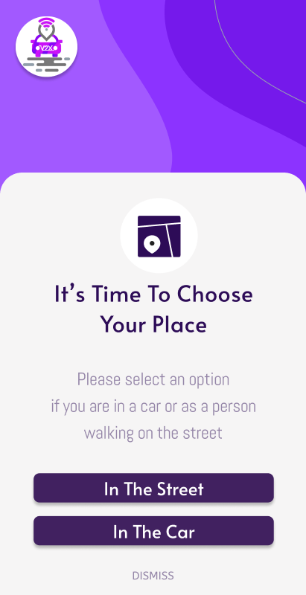
Mobile Application
1
Get Started
2
Ask User
in Street
in Car

Slide 25
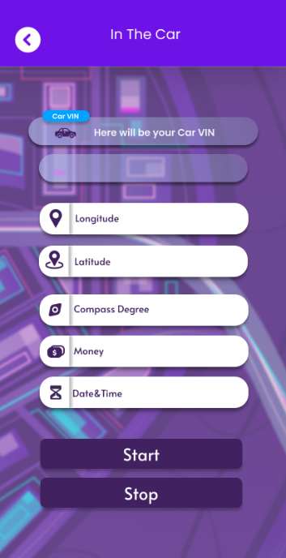
Mobile Application
In car
1
VIN Vehicle
2
Start Button
If no VIN ?
Get GPS Location
Get Compass
Get Warning
And no Start

Slide 26
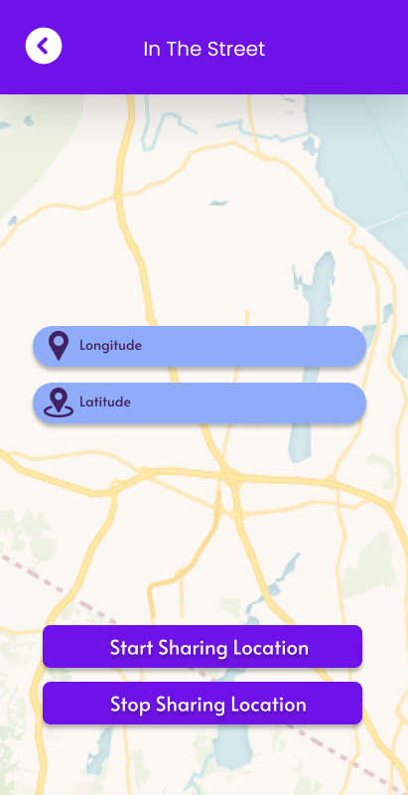
Mobile Application
In street
Create Unique id Topic
Create Dynamic id Topic
30.8330481
29.3242895
Static Topic: “R9-3A-87e7e464828f4945”
Dynamic Topic: “29,3242-30,8330 ”

Slide 27


V2P
Vehical
Communcate
Variable Location
In Street
Pedestrian
Dynamic Location
Update in firebase Cloud
Create new Location Range
Remove Old Location Range

Slide 28

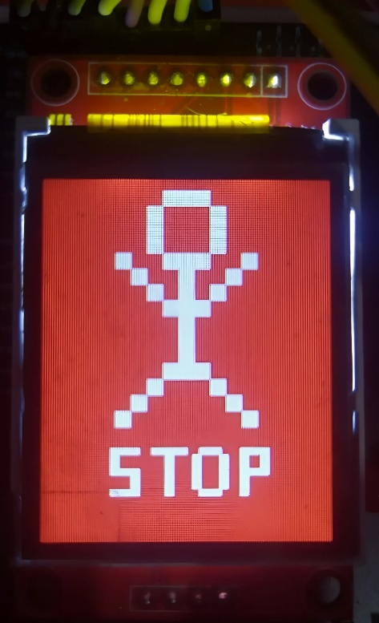
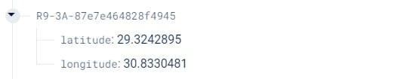

V2P
In Application
In Car
ID Topic
ID Pedestrian
R9-3A
Longitude
Latitude
Range Topic
Warning Flag
To Use in Car and App

Slide 29
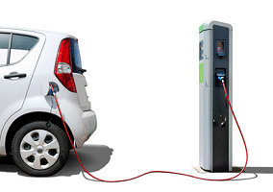
V2G Communication
Frame from vehicle to station
Frame from station to vehicle
Length
Code ID
Data
ACK ID
Length of Data
Data
1 Byte | 1 Byte | Variable length
1 Byte | 1 Byte | Variable

Slide 30
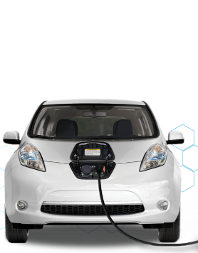
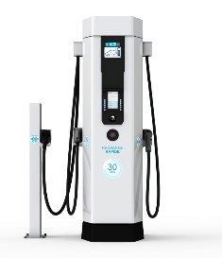




V2G Communication
Pulg Cable
Identification
Identification
Charging Parameter
Charge Cost
Charge Cost

Slide 31
Self-Driving
Predefind Point Location
Current Point Location
Compare With
IF
Continue Self-Driving
Reach Predefind Point
Continue Next Point

Slide 32

Self-Driving Bearing
Compress Degree
Predefind Point Degree
Compare With
To Help at The Roturn

Slide 33

Future Work
1
Create Our Cloud Server
2
Handle Multi-Communication
3
Complte V2X Types
4
Improve Self-Diriving
5
Expands AI Application

Slide 34
Thank You

